Slide 1

Design and Validation of a Framework for Emerging Nanoscale Memory Characterization on an FPGA Platform
D-ITET
Jeff Ren
Semester Project, MSc ITET
Supervision: Till Zellweger, Dr. Nikhil Garg, PD Alexandros Emboras
Prof. Laura Bégon-Lours, Prof. Mathieu Luisier
03.07.25, Zürich

Slide 2
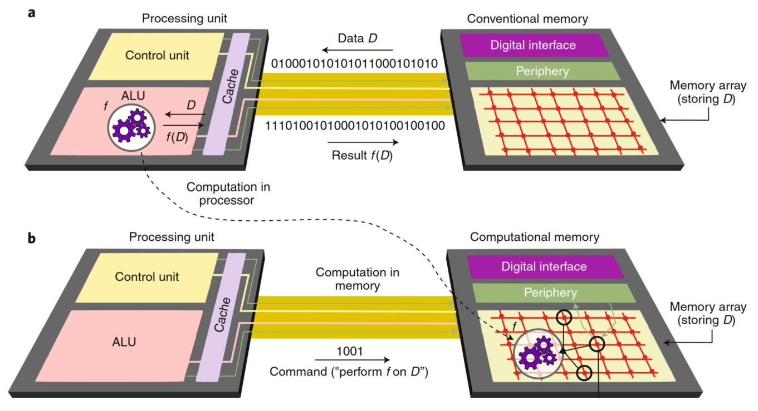
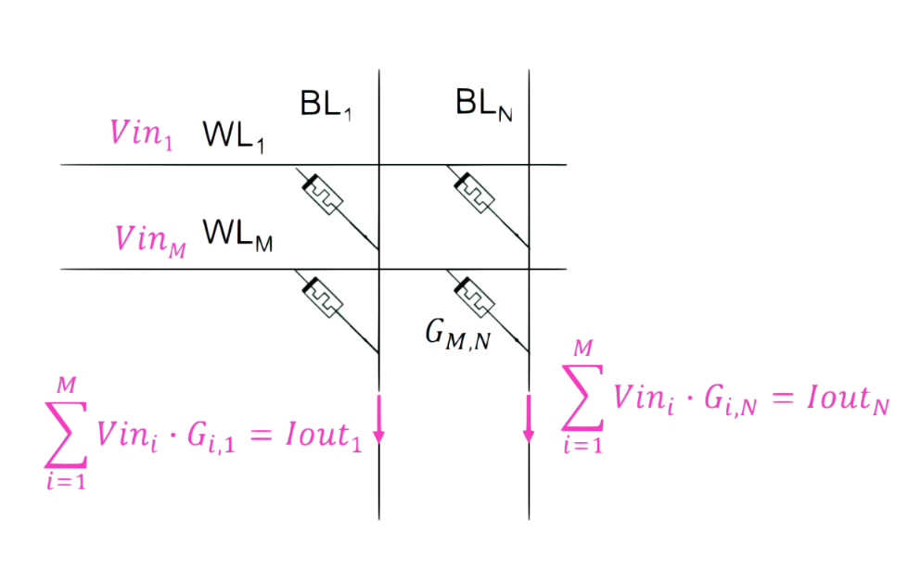
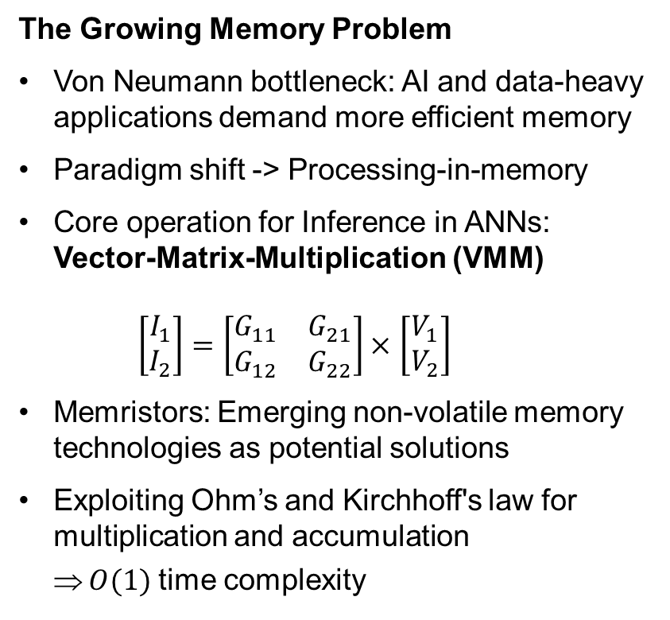
Motivation
The Growing Memory Problem
Von Neumann bottleneck: AI and data-heavy applications demand more efficient memory
Paradigm shift -> Processing-in-memory
Core operation for Inference in ANNs: Vector-Matrix-Multiplication (VMM) $\left[\begin{aligned}I_{1} \\ I_{2}\end{aligned}\right]=\left[\begin{matrix}G_{11} & G_{21} \\ G_{12} & G_{22}\end{matrix}\right]×$ $\left[\begin{aligned}V_{1} \\ V_{2}\end{aligned}\right]$
Memristors: Emerging non-volatile memory technologies as potential solutions
Exploiting Ohm’s and Kirchhoff's law for multiplication and accumulation
$O(1)$ time complexity
Abu Sebastian et al. (2020), DOI:10.1038/s41565-020-0655-z
reproduced from NEO lectures notes, 2025

Slide 3
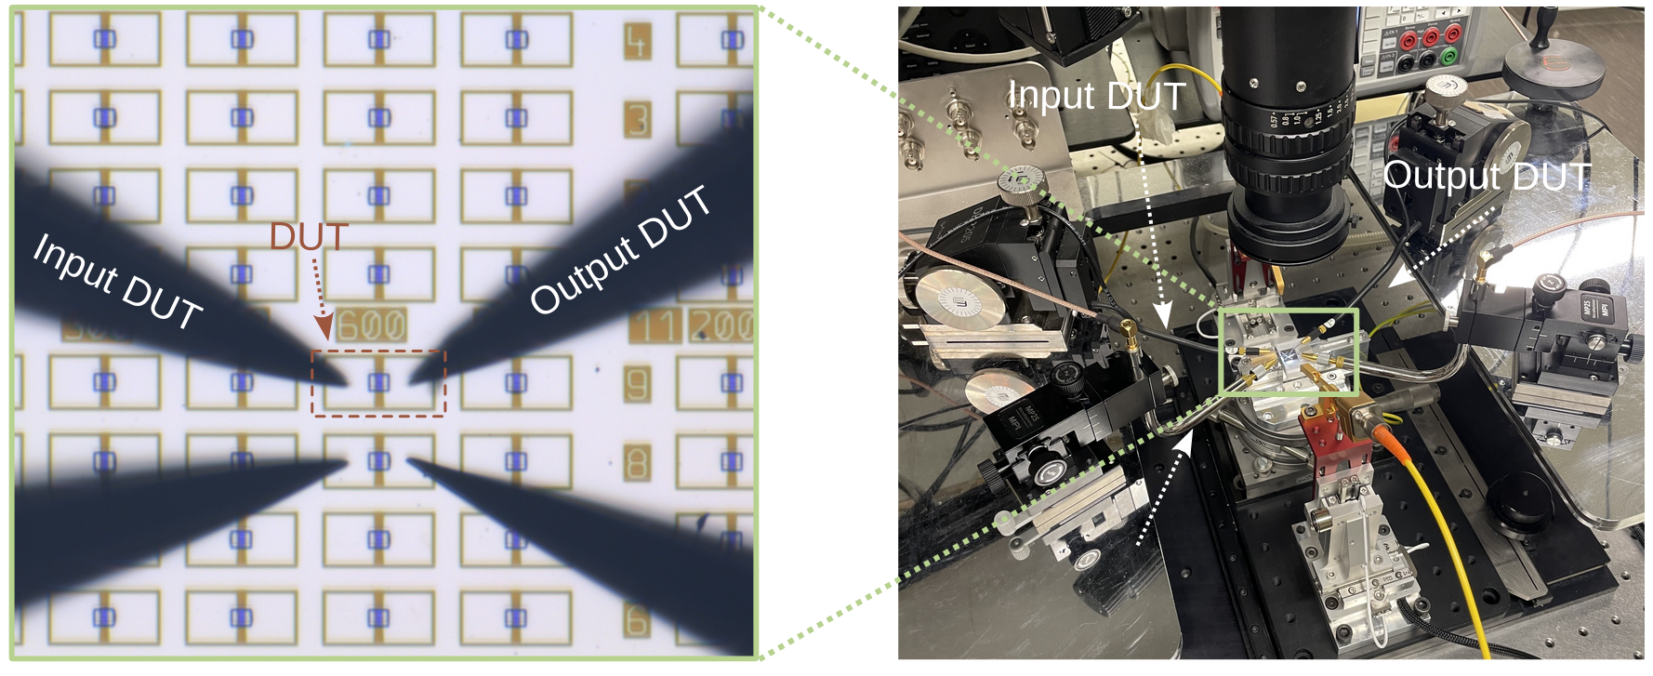
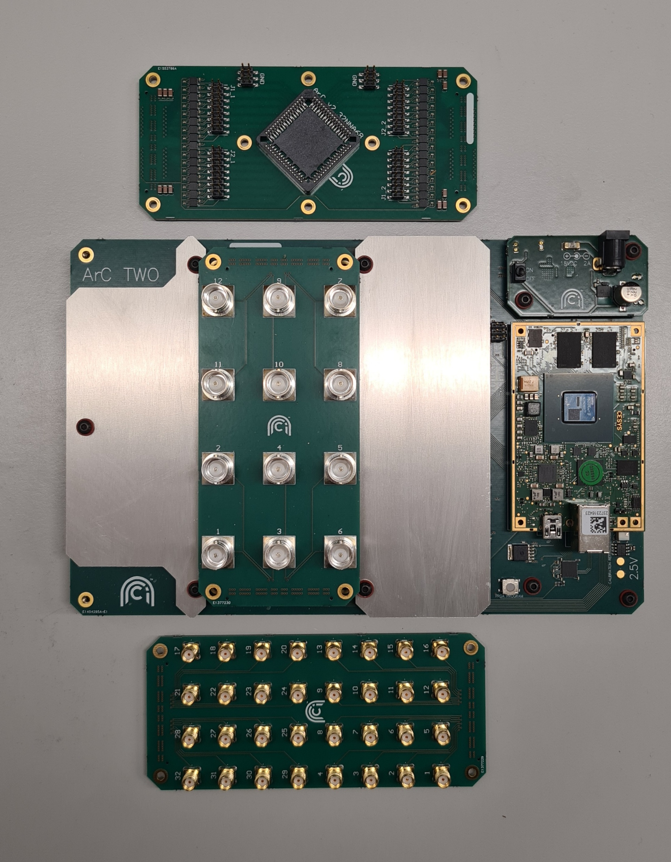
Current Lab Setup and Its Limitations
Current lab setup: Separate SMUs and wave generator with manual probing
BUT: Becomes unpractical for crossbar arrays and scalable testing
Need for new measurement system, capable of measuring larger arrays → ArC TWO

Slide 4
Table of Contents
Motivation and Background
Methods
Device Technologies
ArC TWO platform
Code structure
Results and Discussion
IV
Pulse-based measurements
ArC TWO Nonidealities
Conclusion and Future Work

Slide 5
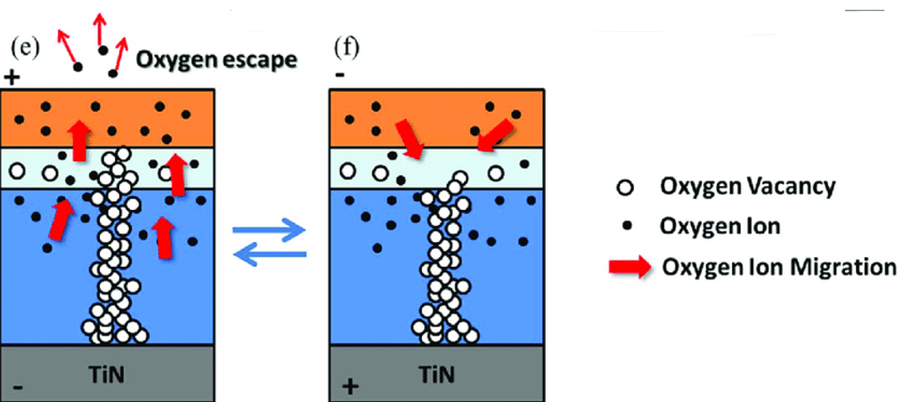
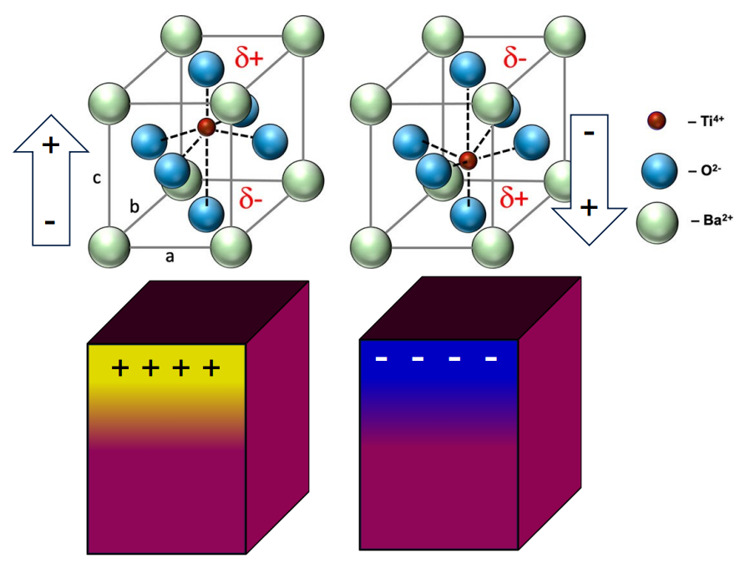
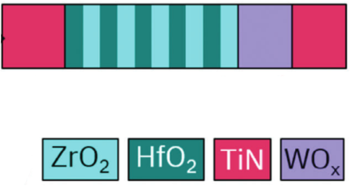
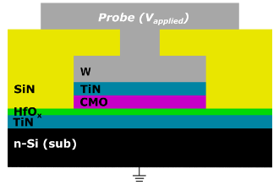
Methods: Device Technologies
Memristive devices: passive circuit element allows for tunable resistance based on the history of applied voltage
Valence Change Memory (VCM)
Utilizes conductive filament formation using oxygen vacancies
Ferroelectric Tunnel Junction (FTJ)
Utilizes polarization direction of ferroelectric materials
Adapted from Kumar et al., Ceramics International, 2017
Adapted from Bégon-Lours et al., 2024
Reproduced from NEO lectures notes, 2025
Adapted from Falcone et al., 2023
Notes:
VCM: filament formation using oxygen vacancies
FTJ: modulates polarization direction of ferroelectric => modulates tunnel barrier

Slide 6
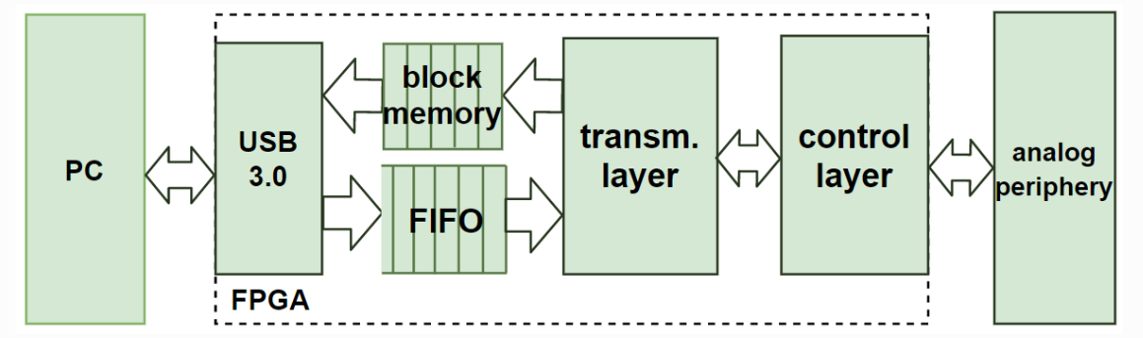
Methods: ArC TWO platform
FPGA-based characterization system
64 independent analog SMU channels (10mA per channel) and pulse generators (40ns – inf pulse width)
32 digital outputs, arbitrary high/low at ±13.5V
32 digital I/Os, arbitrary high level at 1.8-5.5V
Modular daughterboard system (BNC, SMA, chip socket)
Hardware implementations based on Rust with wrapper Python API
Chip Socket
Power
Connector
BNC
FPGA
USB 3.0
SMA

Slide 7
Methods: Code Structure
Overview
Automated measurement framework for pulse-based protocols and IV measurement with visualization tools
Implemented single device protocols:
IV measurement
Pulse-based measurements
LTP/LTD (gradual switching)
Retention
Endurance
Crossbar module (proof of concept):
Handles correct addressing of channels
Methods for reading at single crosspoint/all devices using mitigation schemes

Slide 8
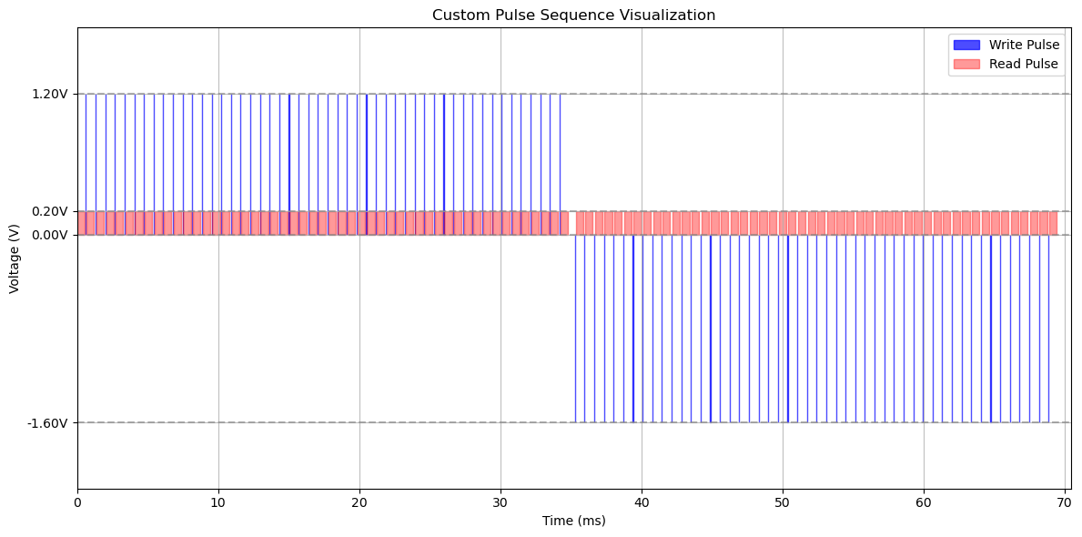
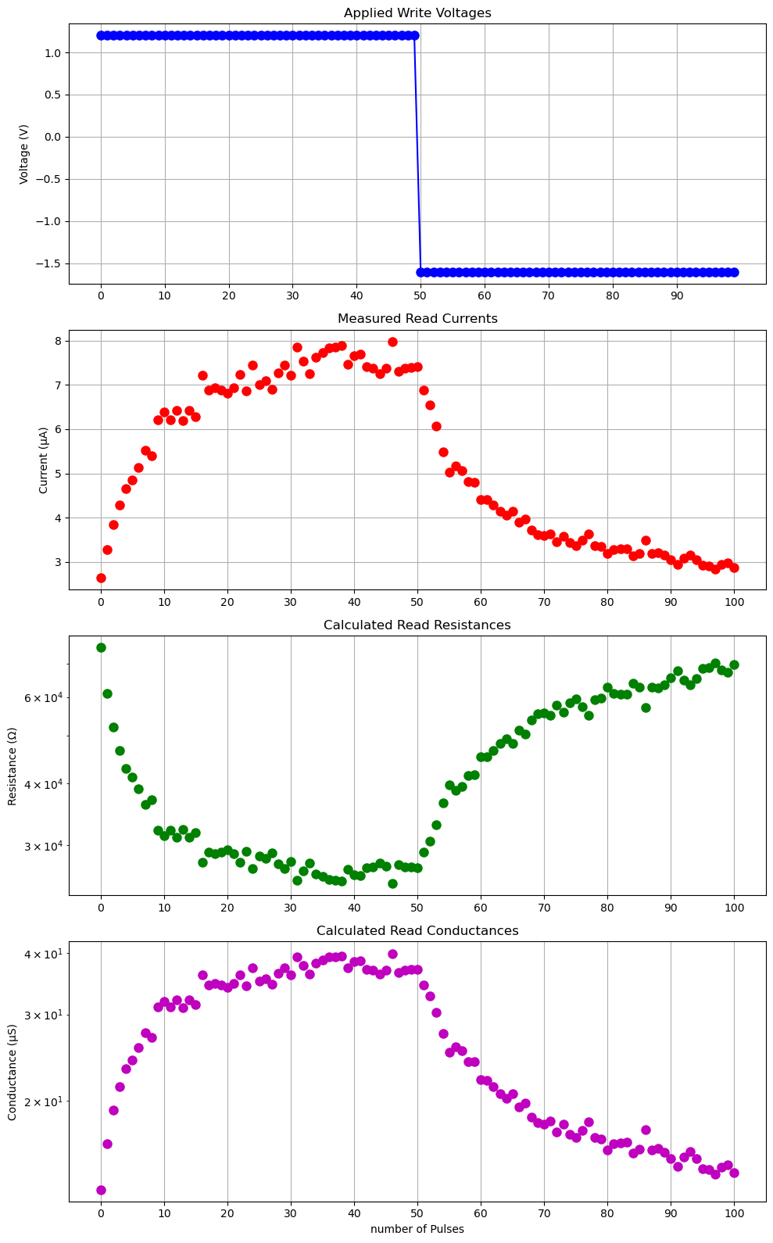
Methods: Code Structure
Measurement Flow
Sequence/Parameter Definition
Visualization
Execute
Result Collection
Data Analysis
IV or Pulse
Notes:
Jupiter notebooks

Slide 9
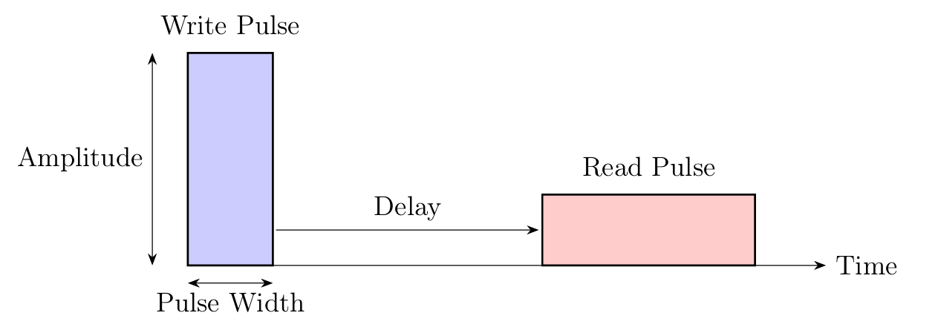
Methods: Arbitrary Pulsing Framework
Arbitrary Pulsing Parameter Diagram
Pulse type
Write or read
Amplitude
±13.5 V
Pulse Width
Write: Minimum 40ns
Read: Fixed at 500us
Delay
Delay after pulse
Basis for all pulsing protocols
Arbitrary blocks for sequence generation

Slide 10
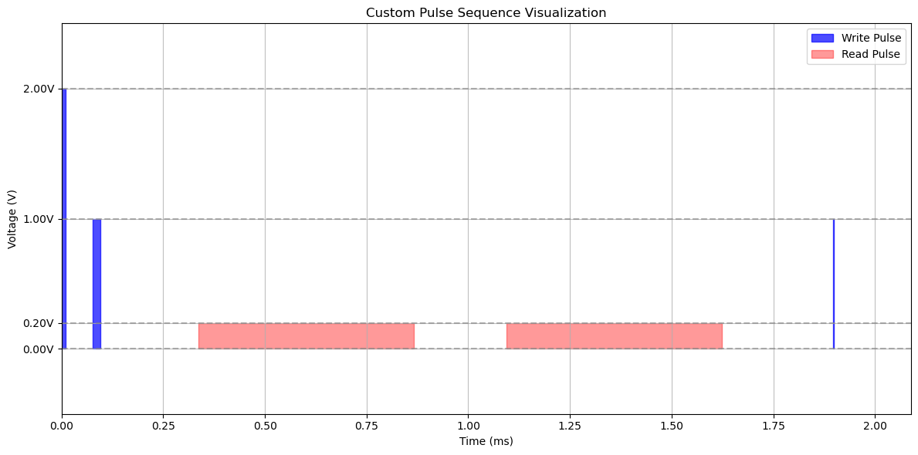
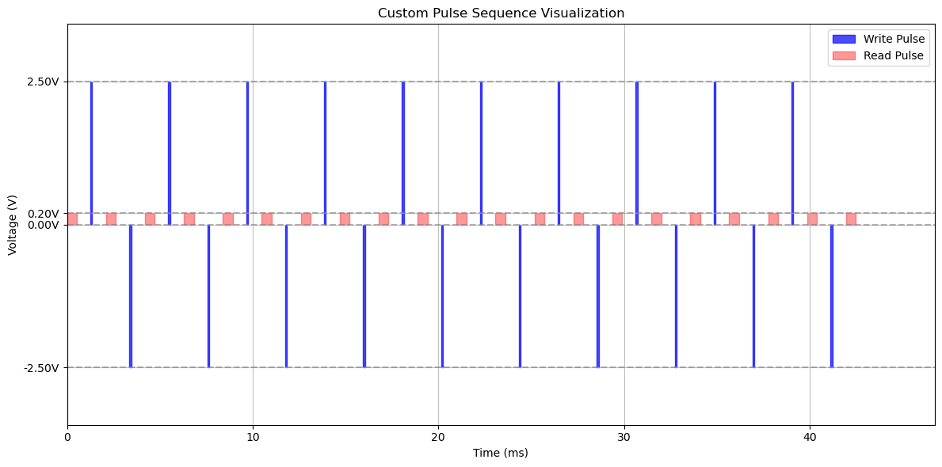
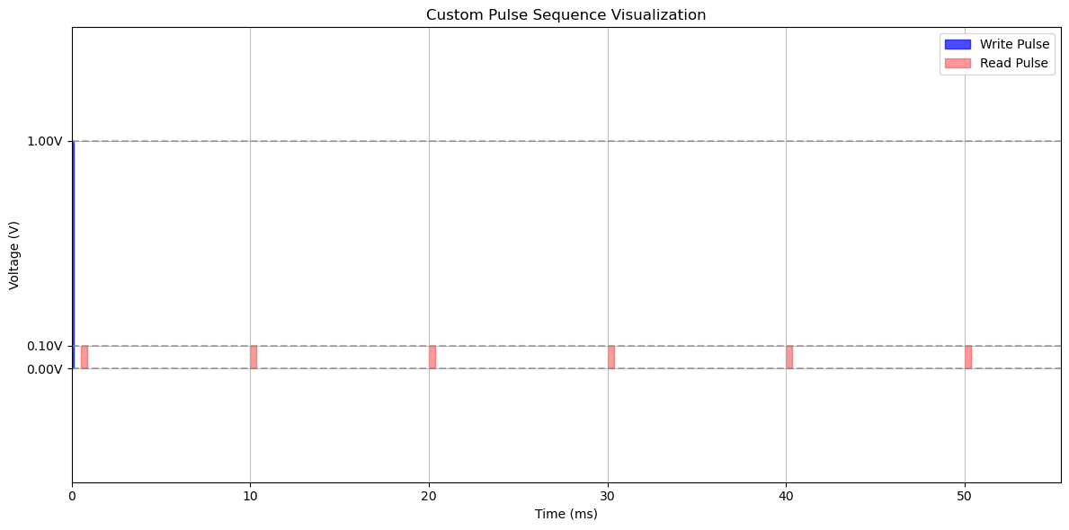
Methods: Arbitrary Pulsing Framework
Arbitrary Pulsing Sequence Examples

Slide 11
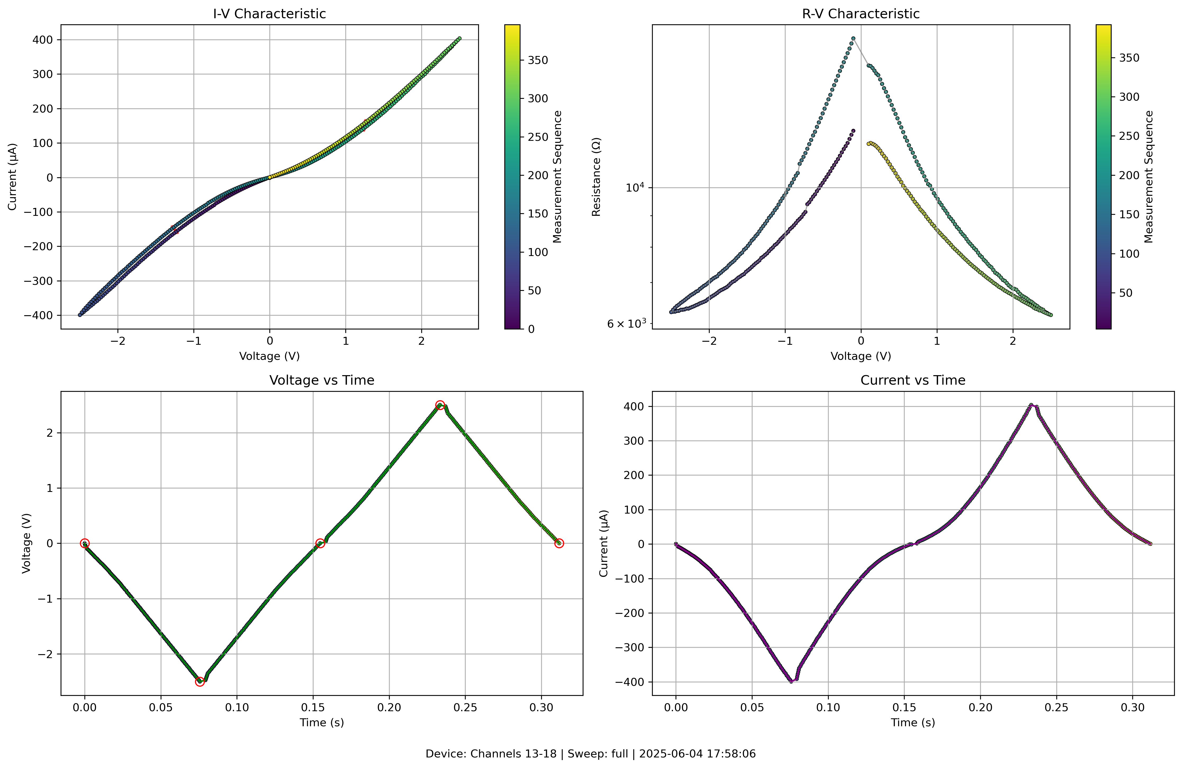
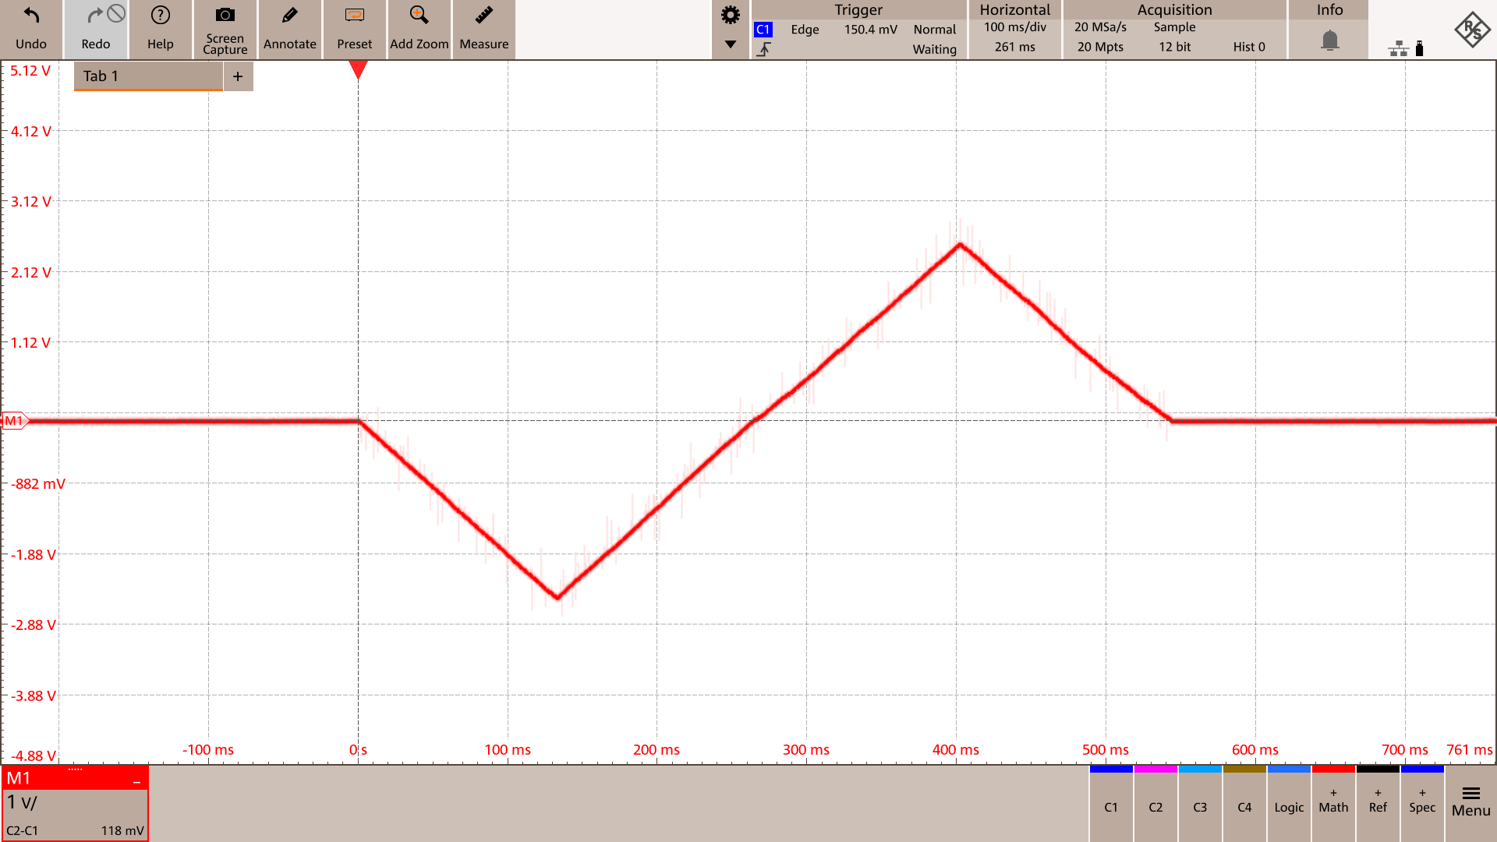
Results: IV
ArC TWO measurement
Measurement on VCM
sweep from -2.5V to 2.5V
starts/ends at 0V
400 steps
Current (uA)
Resistance (Ω)
Oscilloscope measurement
Voltage (V)
Voltage (V)
Voltage (V)
Current (uA)
Time (s)
Time (s)
Notes:
initially on state, ~4x resistance window observed on a VCM device

Slide 12
Results: LTP/LTD
ArC TWO measurement
Voltage (V)
Measurement on VCM
constant amplitude at +1.2V and -1.6V
constant pulse width: 10us
50 pulses each
read voltage at 0.2V
Current (uA)
Sequence Visualization
Resistance (Ω)
Voltage (V)
Conductance (uS)
Time (ms)
Number of Pulses
Notes:
VCM: constant voltage amplitude
also resistance window of ~4

Slide 13
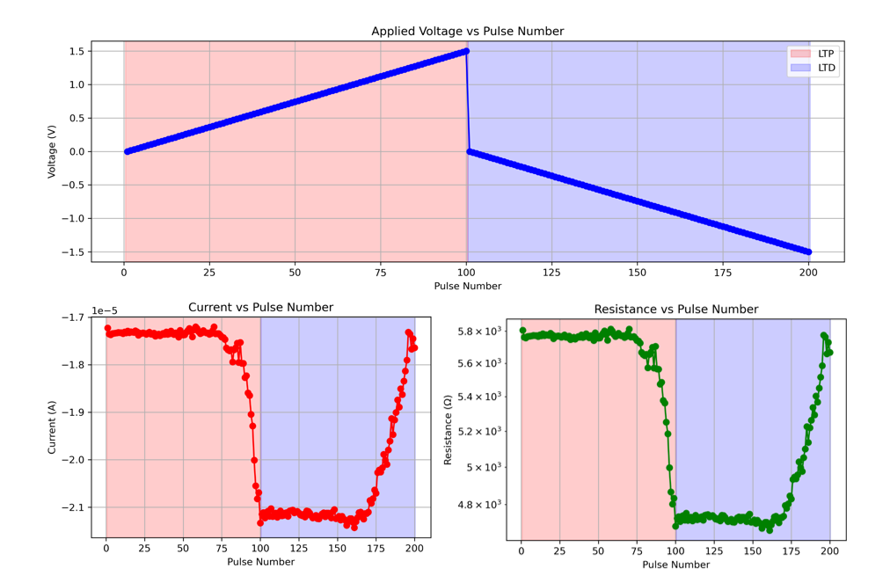
Results: LTP/LTD
ArC TWO measurement
Voltage (V)
Measurement on FTJ
linearly increasing amplitude from 0V to ±1.5V
constant pulse width: 5us
100 pulses each
read voltage at 0.2V
Pulse Number
Current (A)
Resistance (Ω)
Pulse Number
Pulse Number
Notes:
earlier version: measurement on FTJ
In contrast to VCM, linearly increasing voltage pulses form 0 to +/- 1.5V
starts gradually switching after 75 pulses at around 1.1V

Slide 14
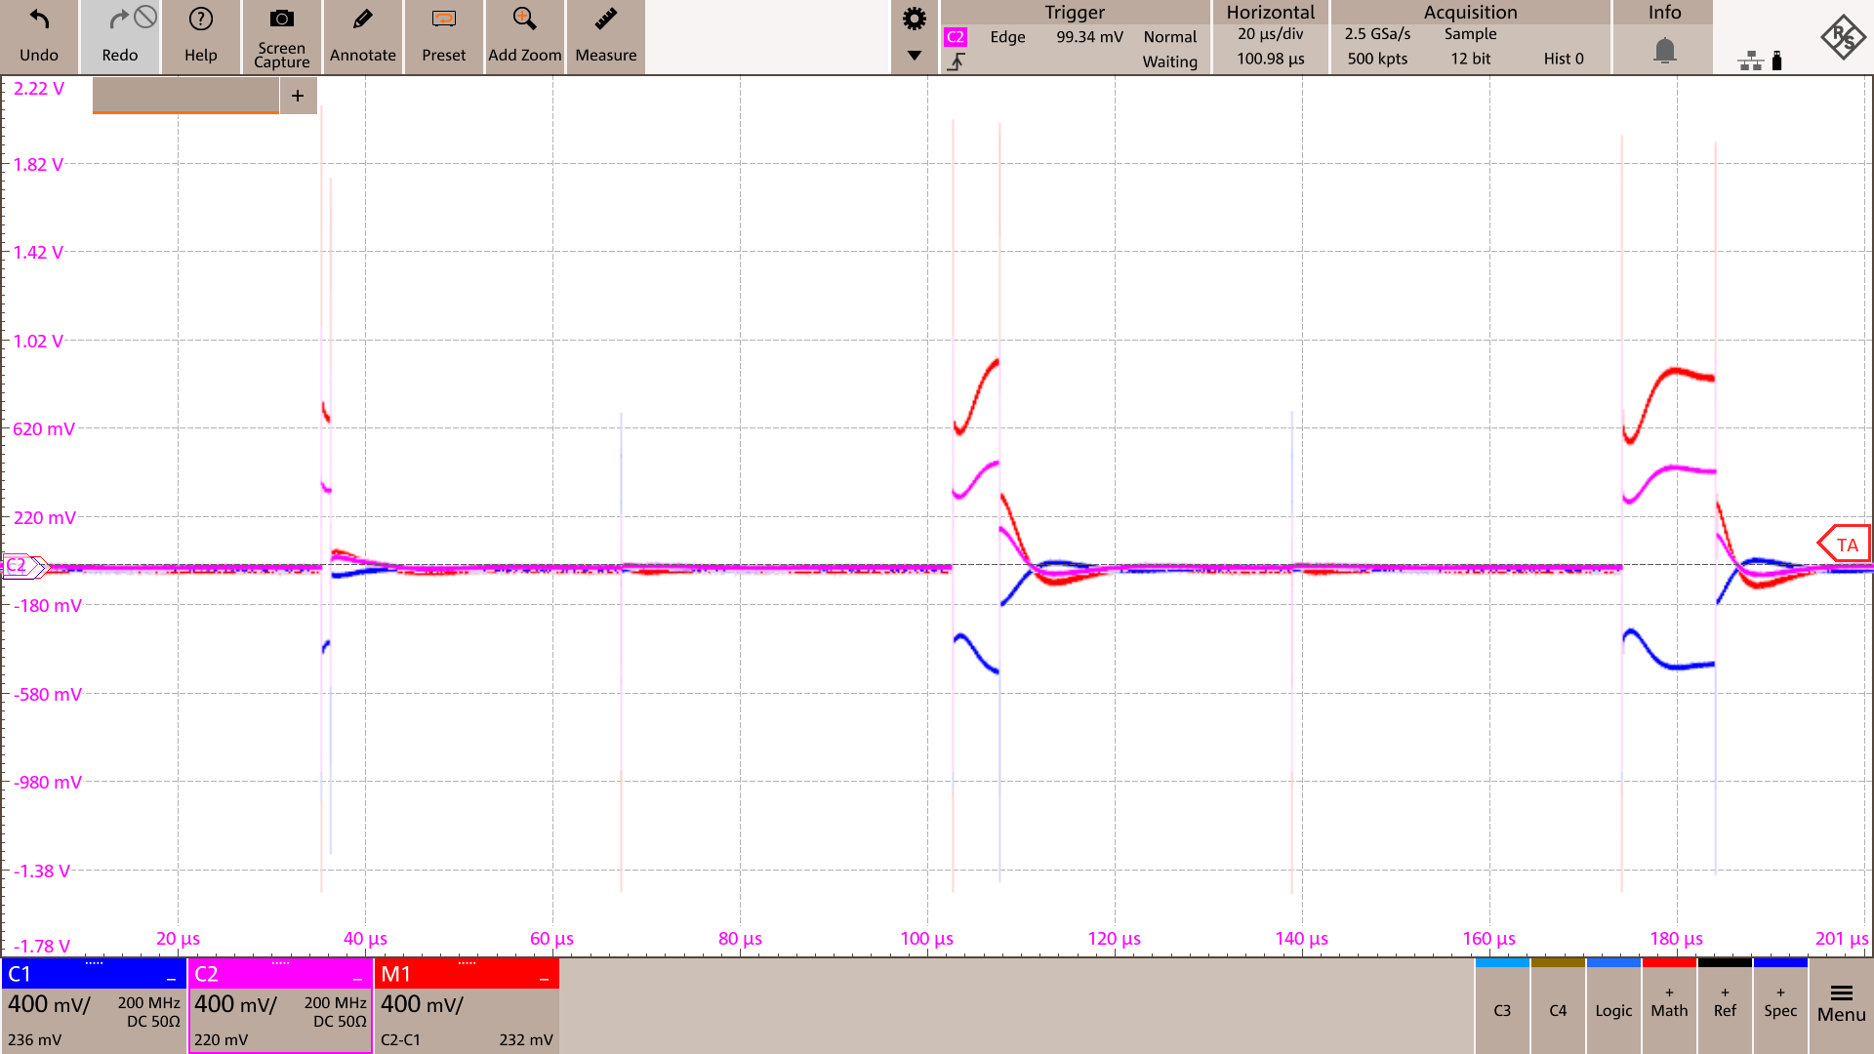
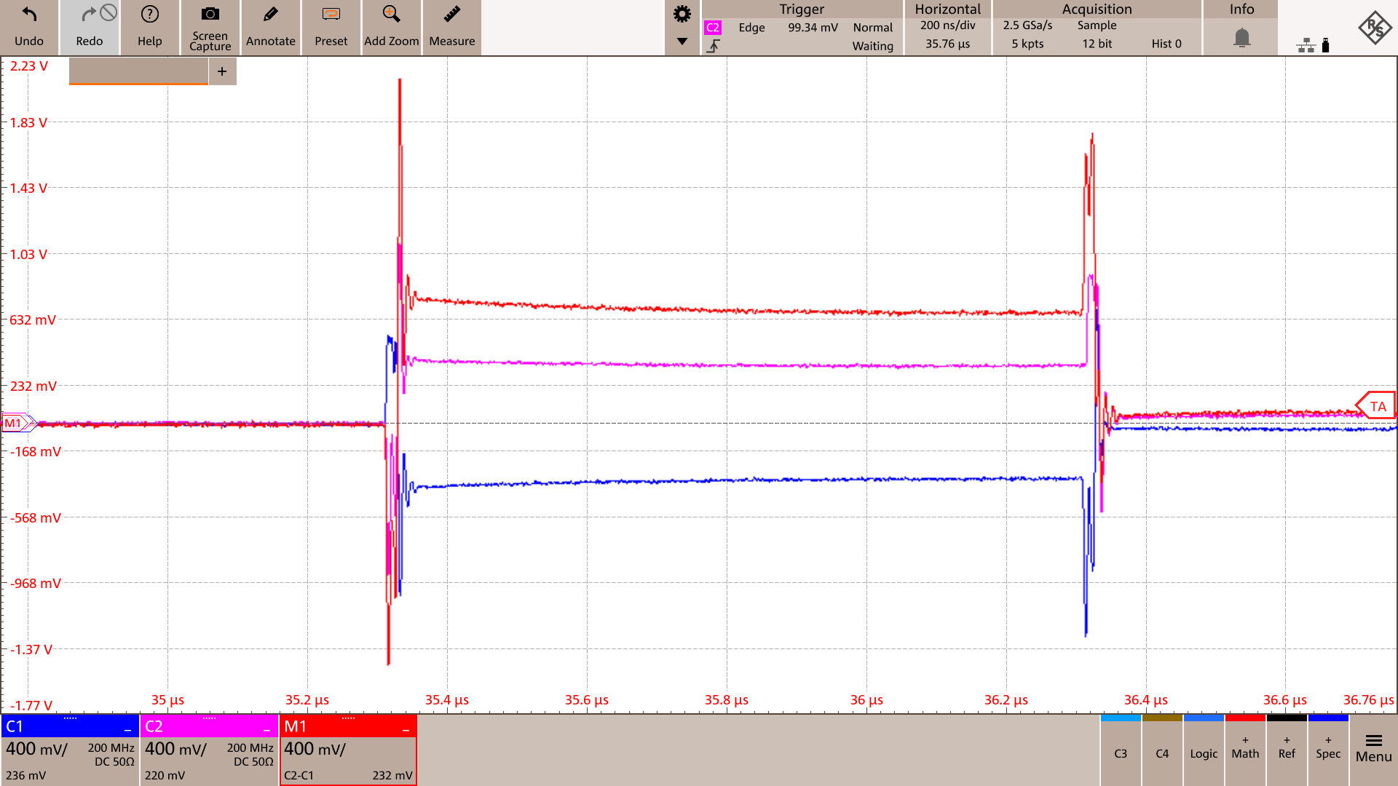
Results: ArC TWO Nonidealities
Measurement
1,5 and 10us pulses at 1V
Long pulse settling time
Spikes in between operations
Over/Undershoot during transients
Notes:
illustrate the next issues with three pulses
pulse settling time, few microseconds => larger capacitances in ArC and BNC breakout board => heuristic compensation
switching spike between instructions => driver circuit dead time, when turning off FET before turning on the other FET, output gets capacitvly coupled.

Slide 15
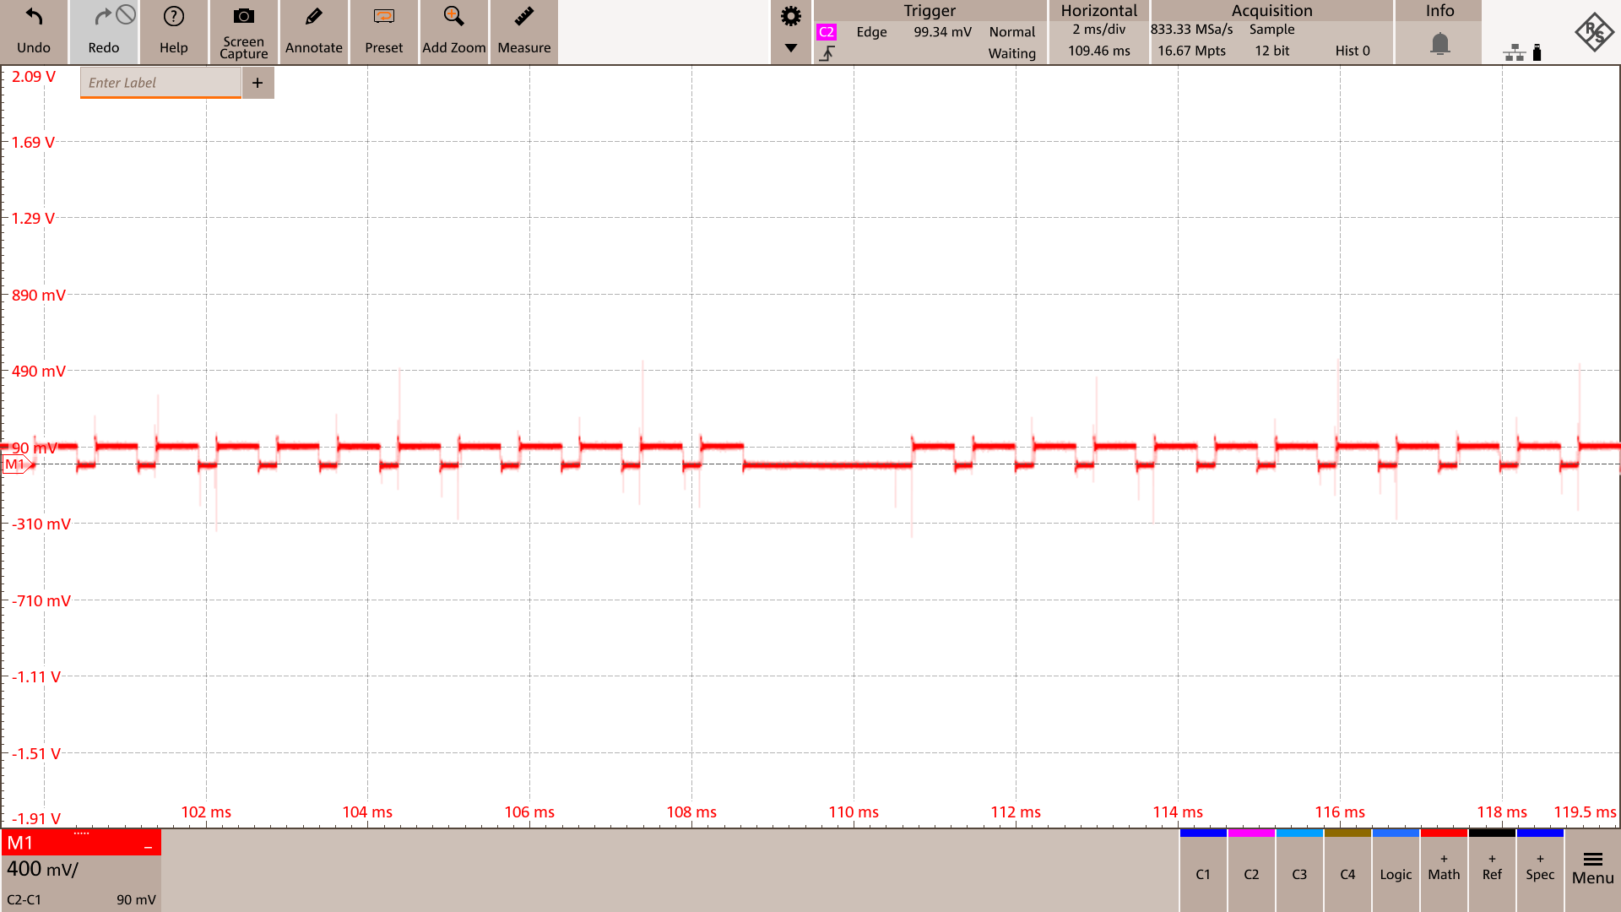
Results: ArC TWO Nonidealities
Measurement
Retention test: 300 read operation batched in one sequence
dead time after ~160 read pulses during batched execution
block memory fills up
offloading of results to PC required before continuation
Notes:
during a retention test, larger gap/dead time during execution after ~160 read instructions
defferred read operations => fills up block memory, FPGA moves

Slide 16
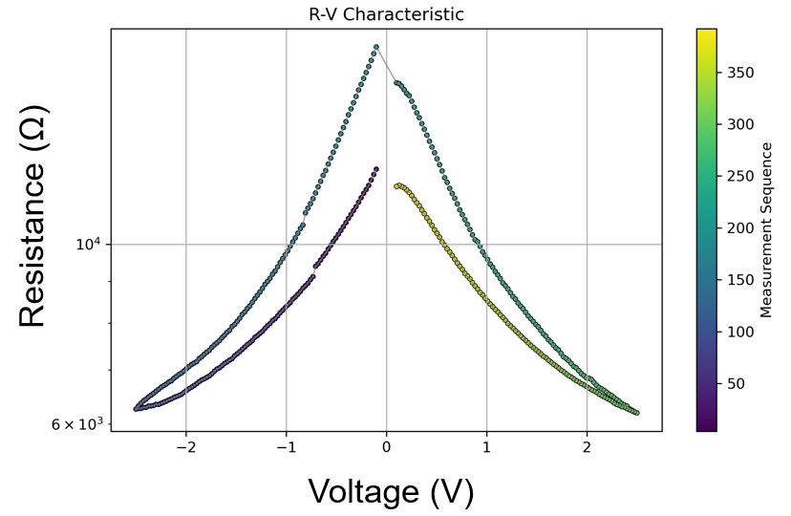
Conclusion and Future Work
Conclusion
Developed modular software framework for automated device characterization
flexible arbitrary pulsing
Implemented single device measurement protocols for IV and pulse-based operations
successful testing on VCM and FTJ
Identified and partially mitigated system limitations (pulse settling time)
Future Work
Extend crossbar module for device programming
Validation on real, wire-bonded crossbar arrays
Compliance current control
Mitigation of transient voltage spikes (PCB rework with RLC filter or filtered daughterboards)

Slide 17
Q&A
Any questions?

Slide 18
Back up slides

Slide 19
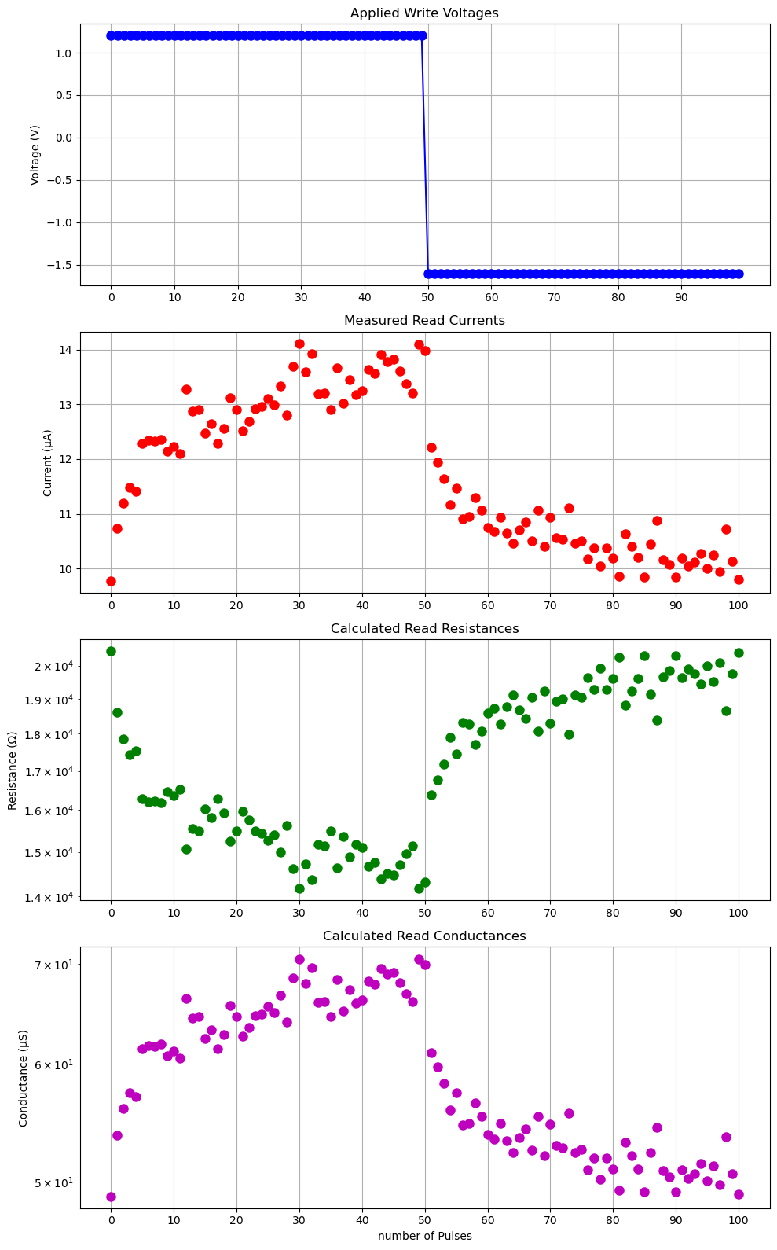
Results: LTP/LTD
Differential biasing
Single sided biasing
measurement on VCM
ltp_voltages = np.linspace( 1.2, 1.2, 50)
ltd_voltages = np.linspace(-1.6, -1.6, 50)
read_voltage = 0.2
pulse_width_ns = 10_000
read_delay_ns=100_000
write_delay_ns=50_000, inter_phase_delay_ns=500_000
Notes:
VCM: constant voltage amplitude
also resistance window of ~4

Slide 20
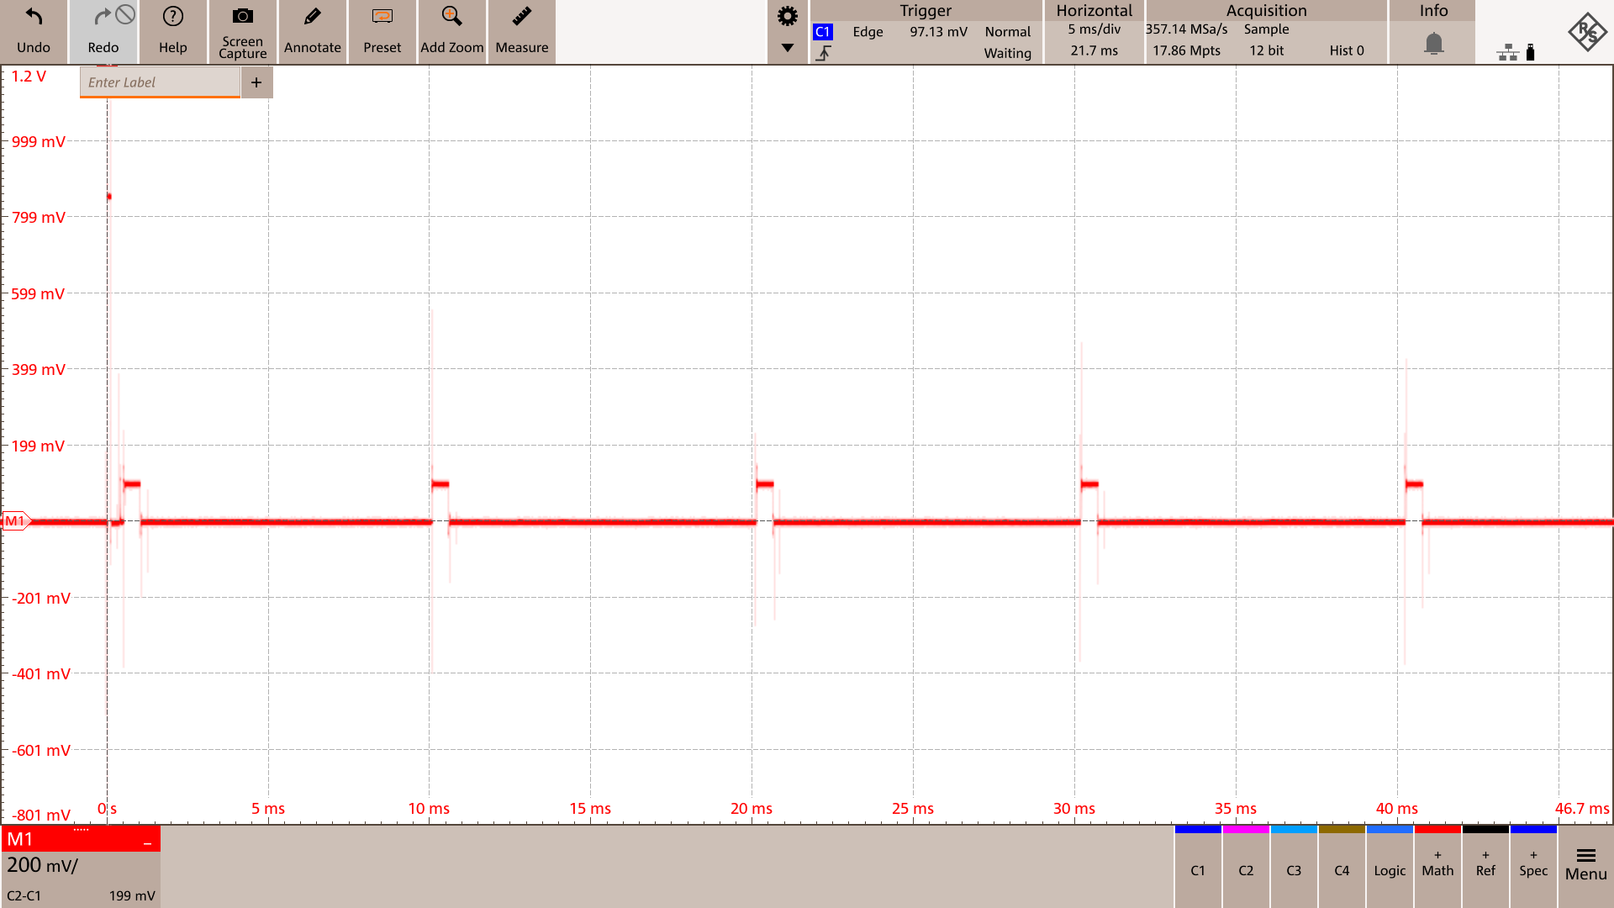
Results: Retention
Retention and Endurance
set_voltage = 1
read_voltage = 0.1
set_pulse_width = 100 _000
read_times_sec =
[0.0005 ,0.01 ,0.02 ,0.03 ,0.04 ,0.05]

Slide 21

Results: Endurance
Retention and Endurance
num_cycles = 10
set_voltage = 2.5
reset_voltage = -2.5
read_voltage = 0.2
pulse_width_ns =100 _00 std_delay_ns =500 _000
read_interval =1

Slide 22
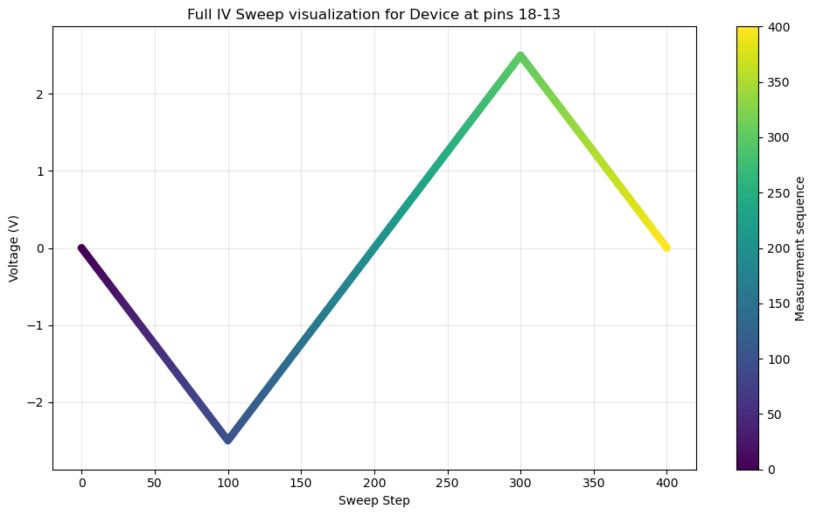
Results
IV measurement

Slide 23
Results
Limitations of the ArC TWO
1us pulse

